Slide 1
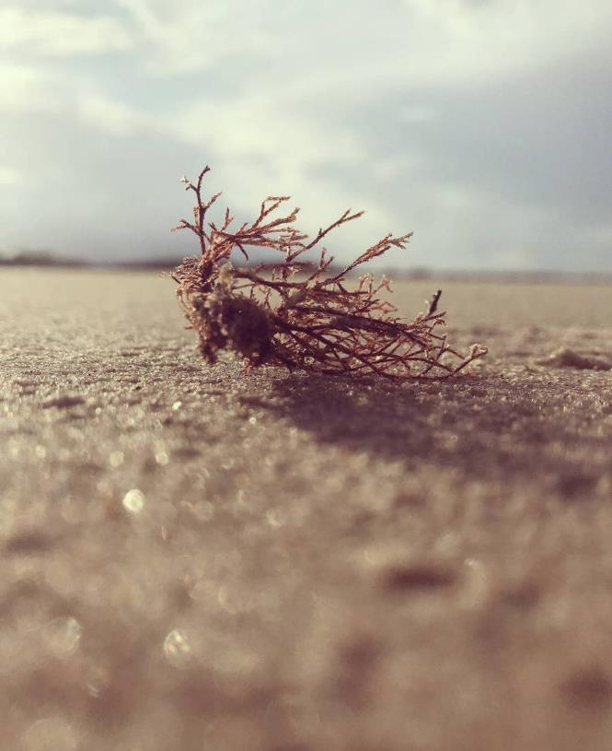
Odesia healthcare
Jagatpur, Odisha

Slide 2
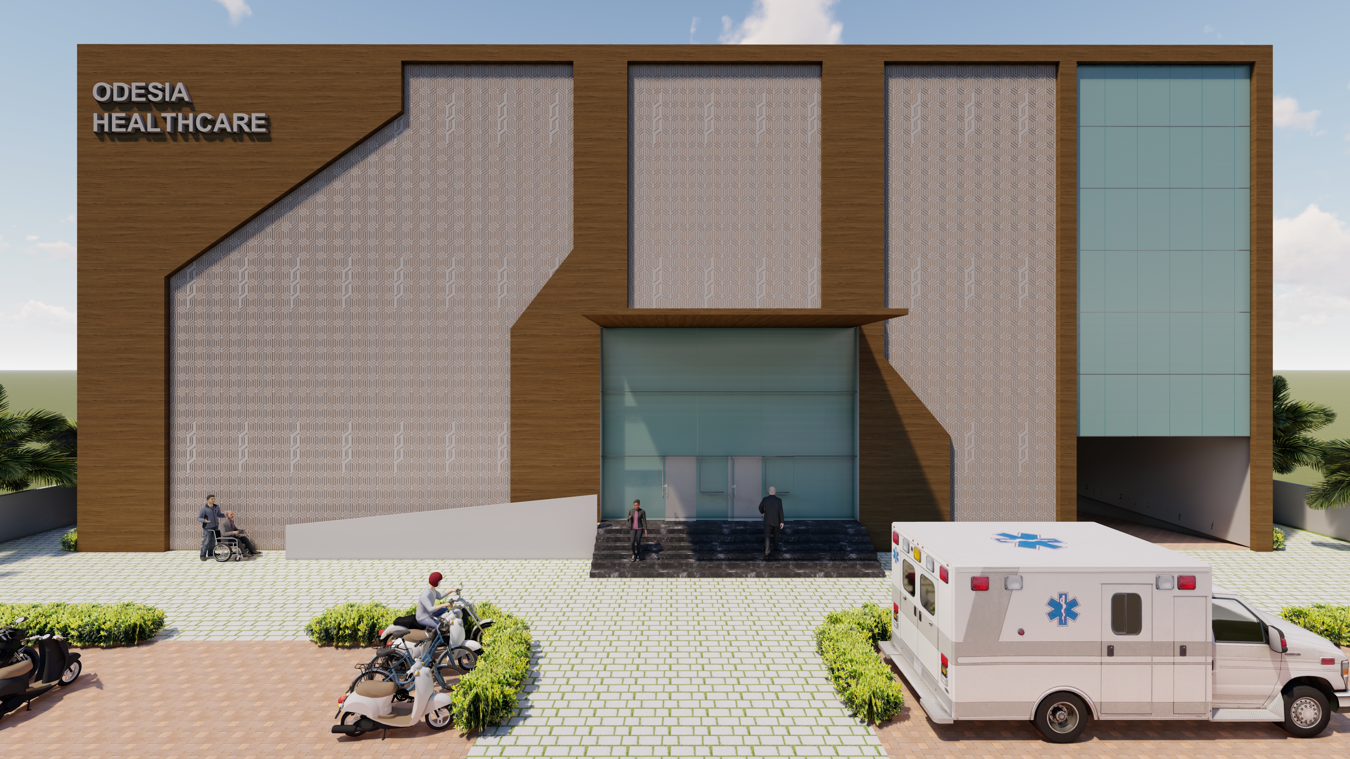

Slide 3
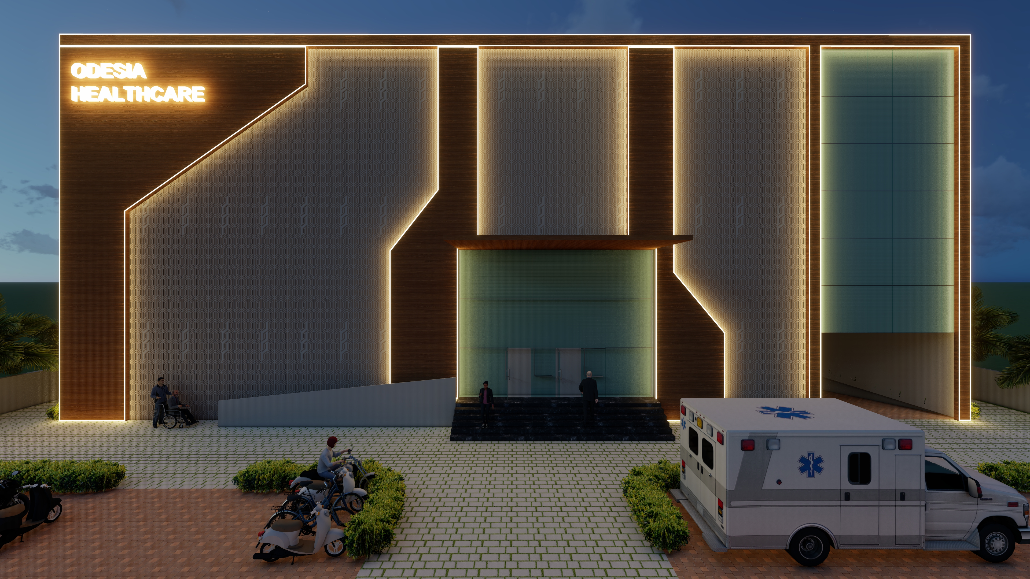

Slide 4
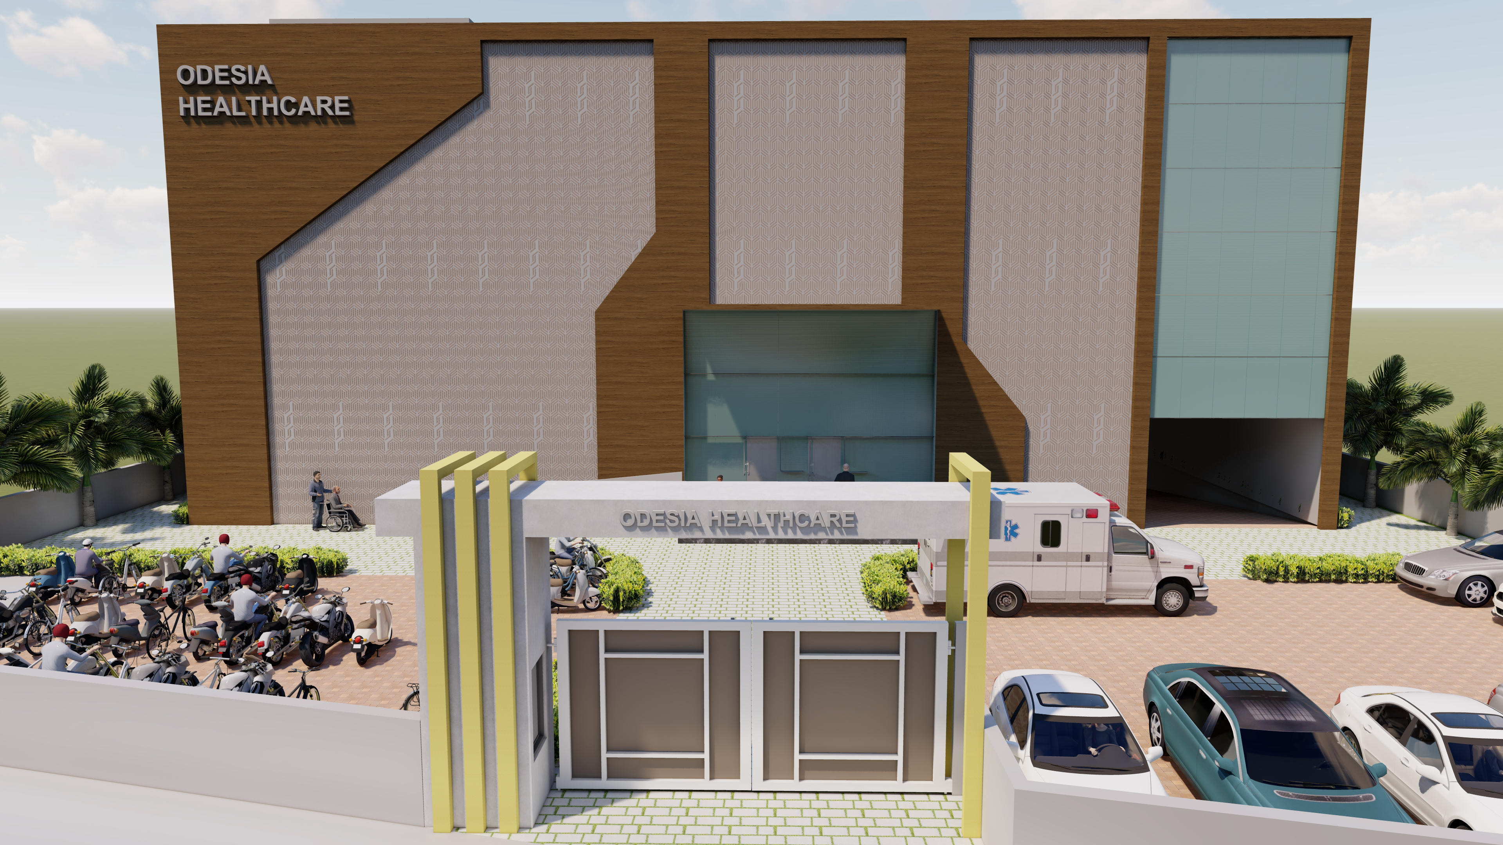

Slide 5
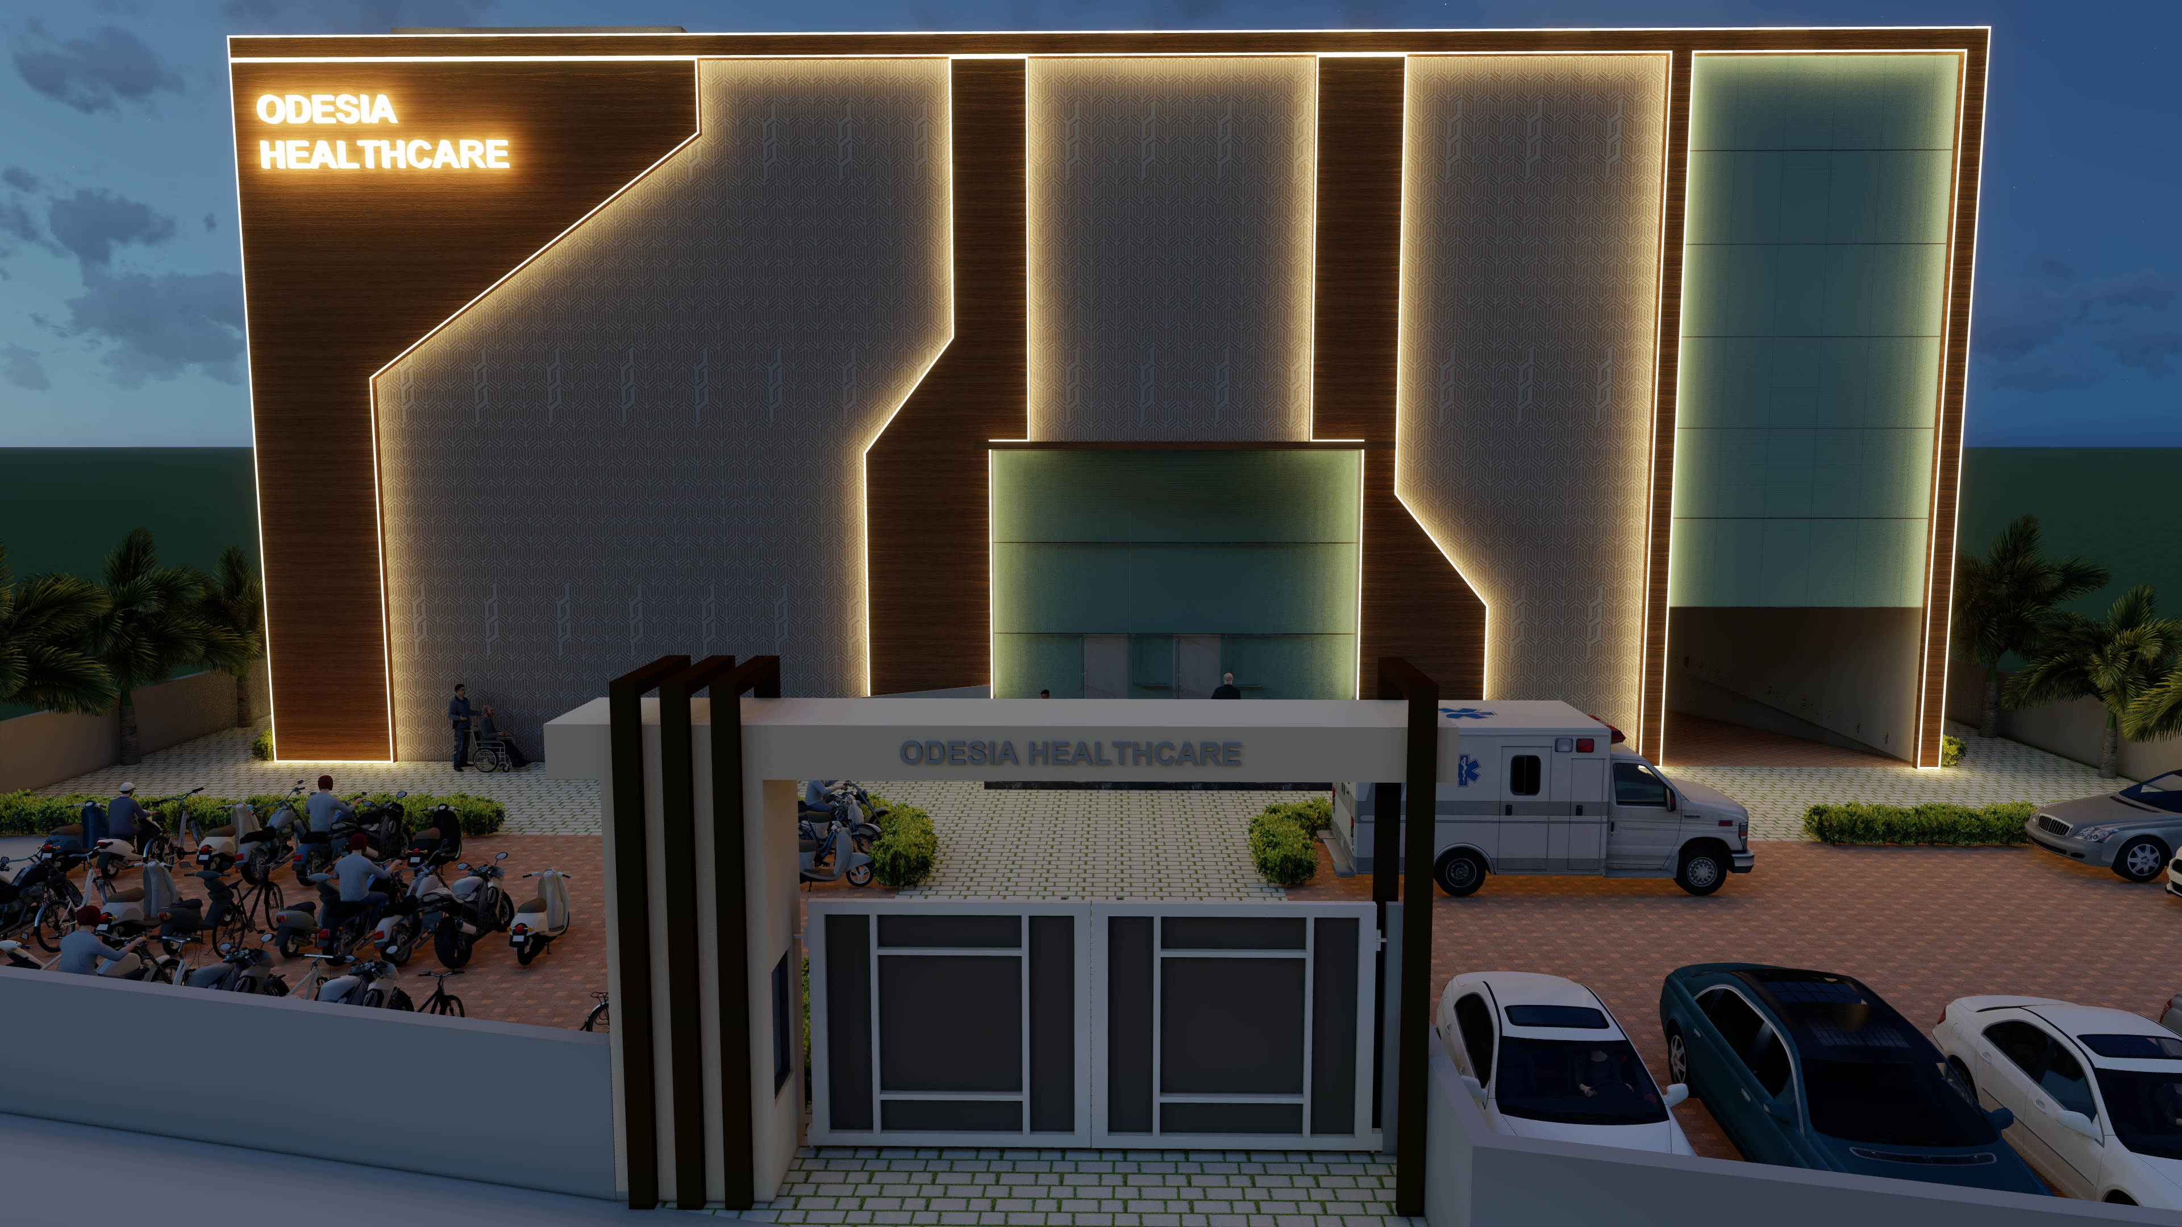

Slide 6
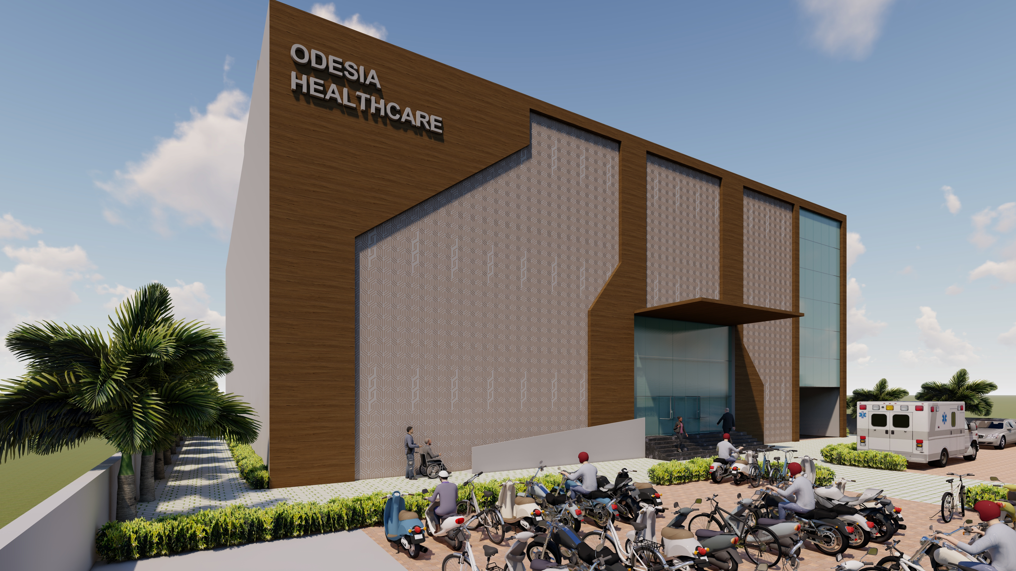

Slide 7
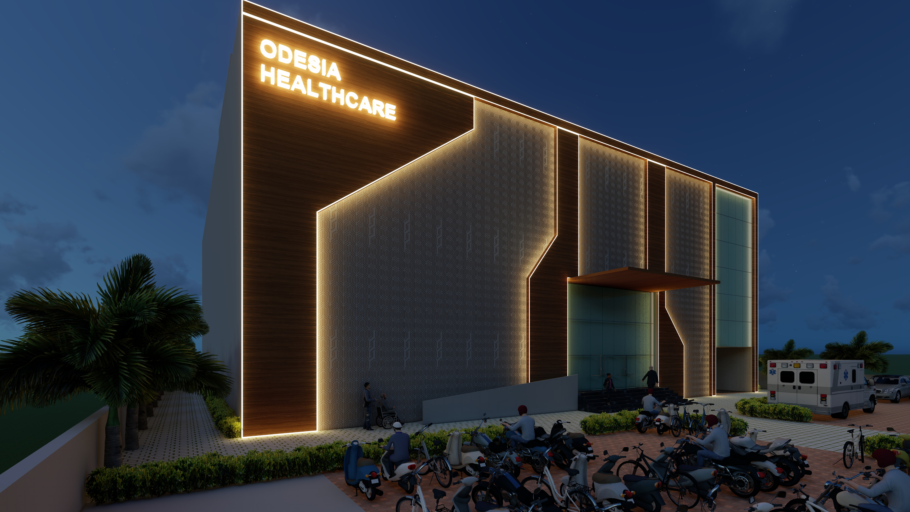

Slide 8
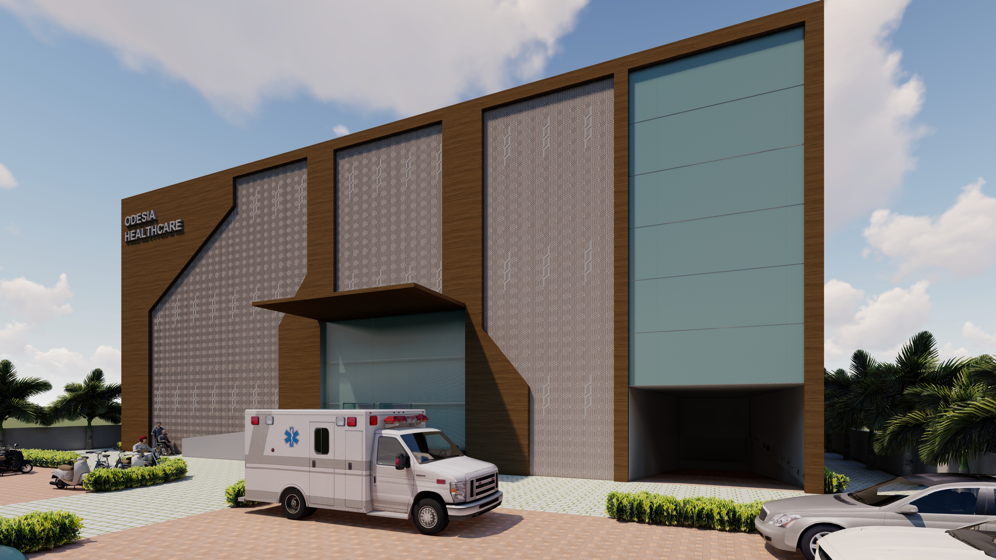

Slide 9
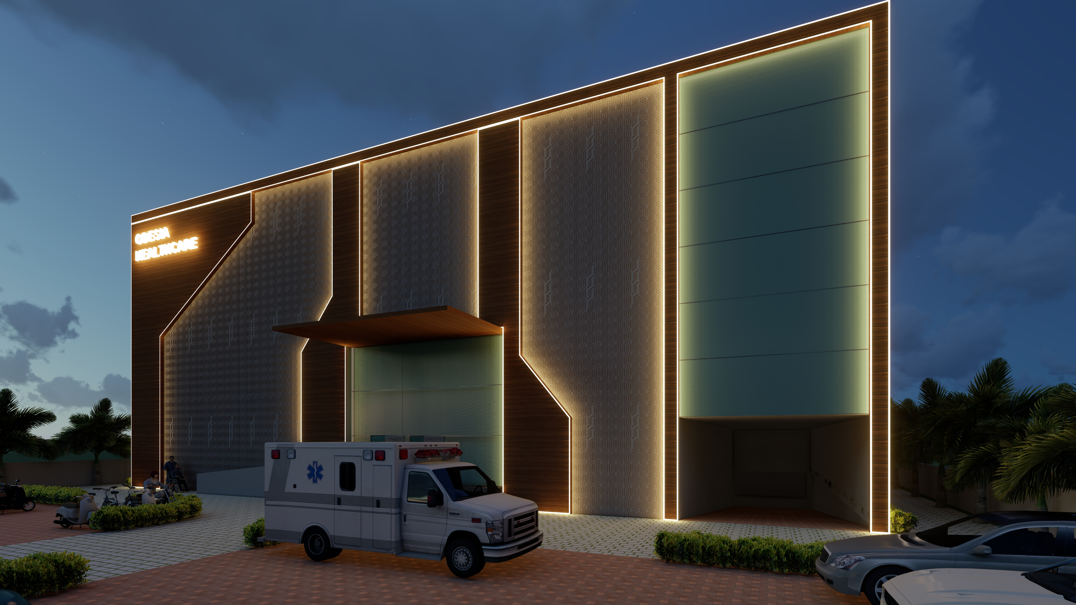

Slide 10
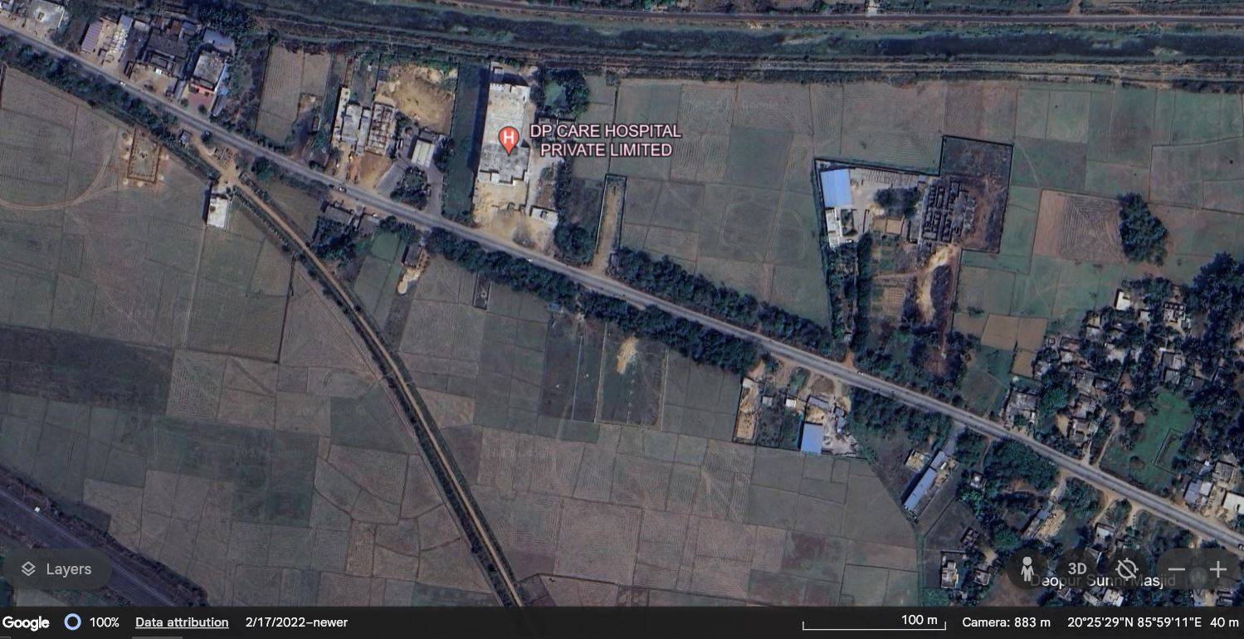
site
Approach road – Cuttack-Paradeep road
Mouza – Deopur
District - Cuttack

Slide 11
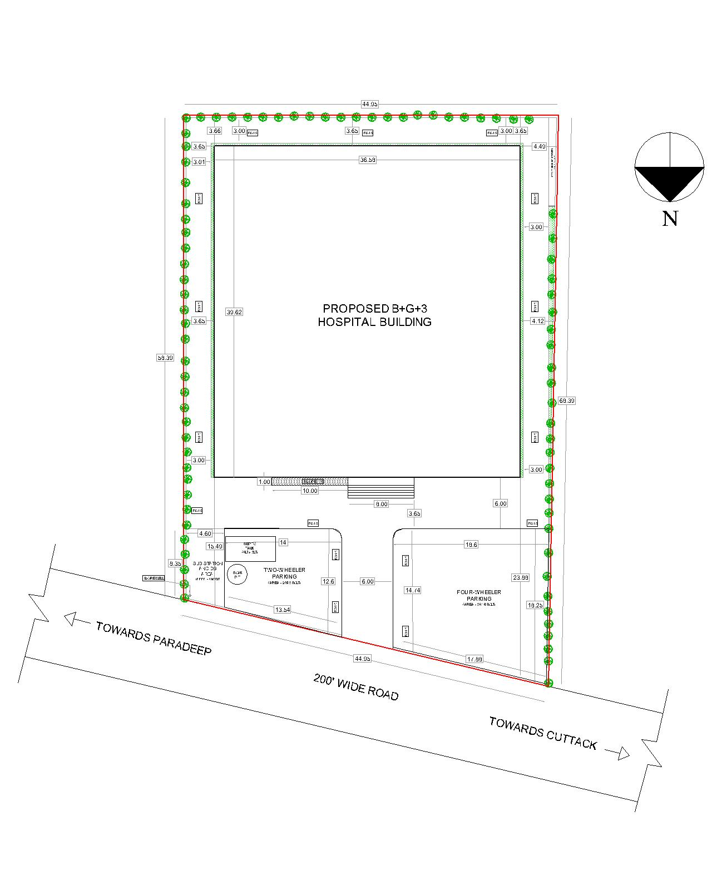
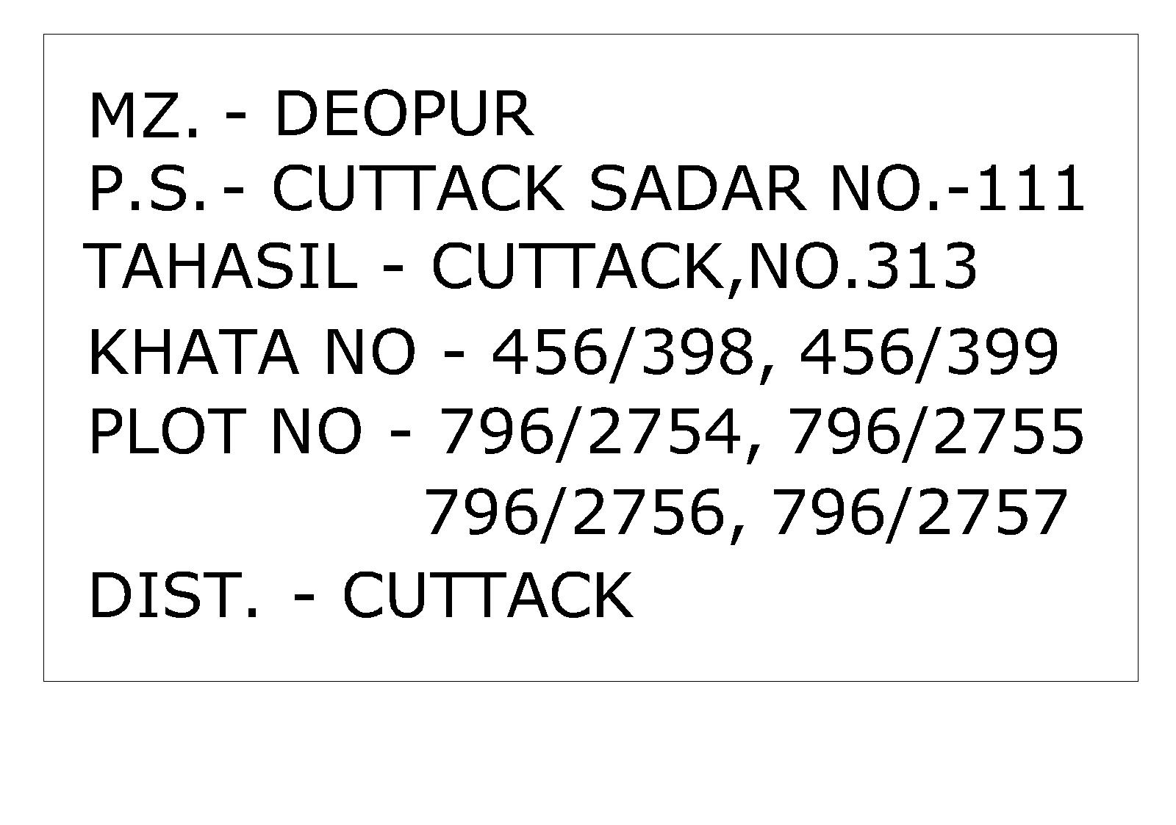
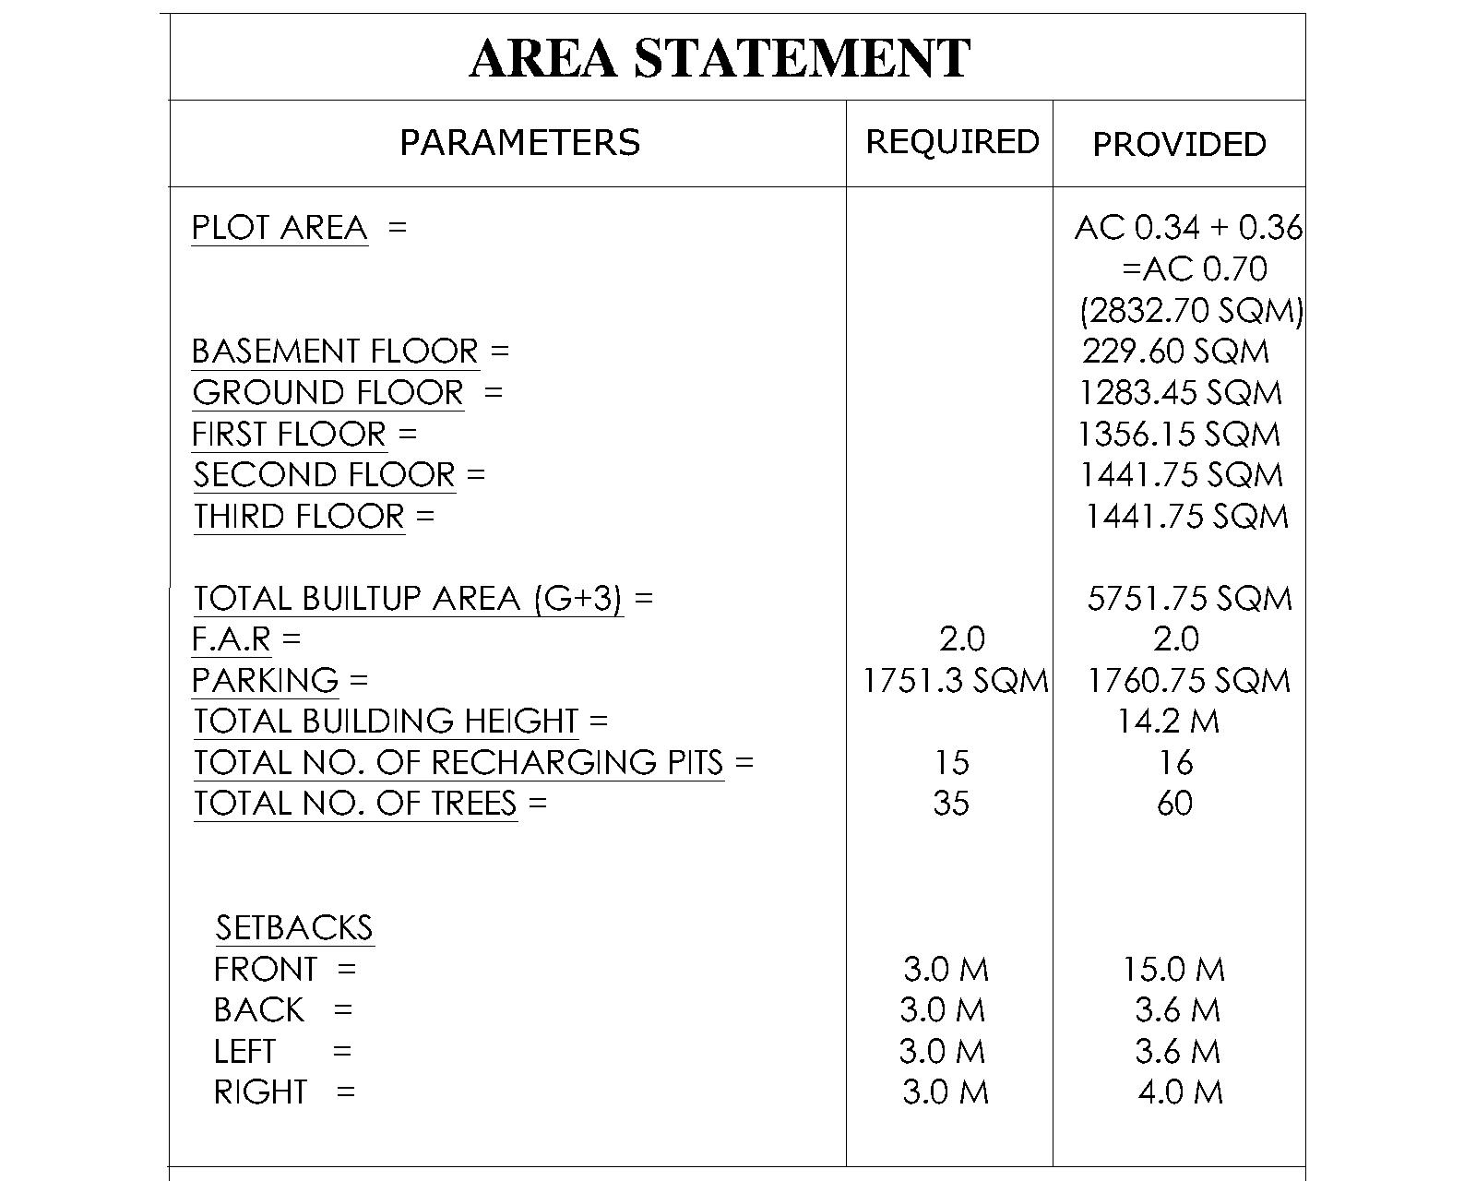
Site plan

Slide 12
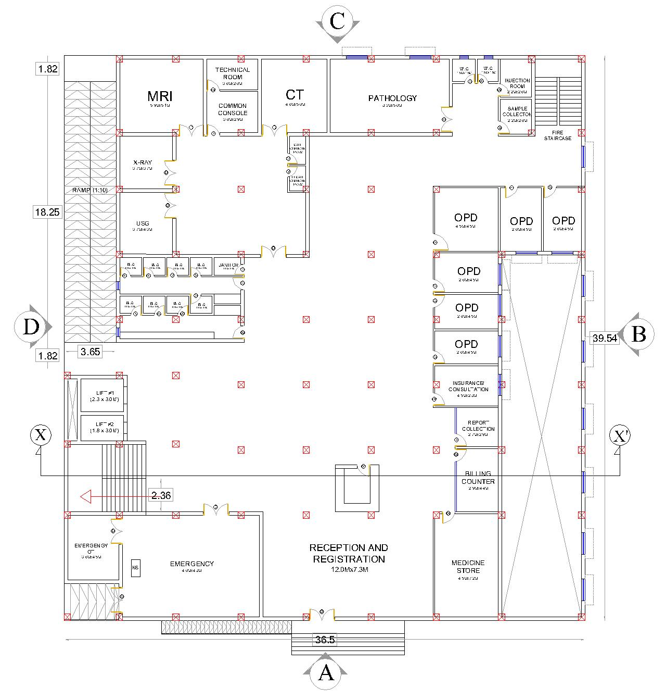
Ground floor
RECEPTION,REGISTRATION AND BILLING
EMERGENCY
PHARMACY
OPD
DEPARTMENT OF RADIOLOGY
PATHOLOGY AND COLLECTION

Slide 13
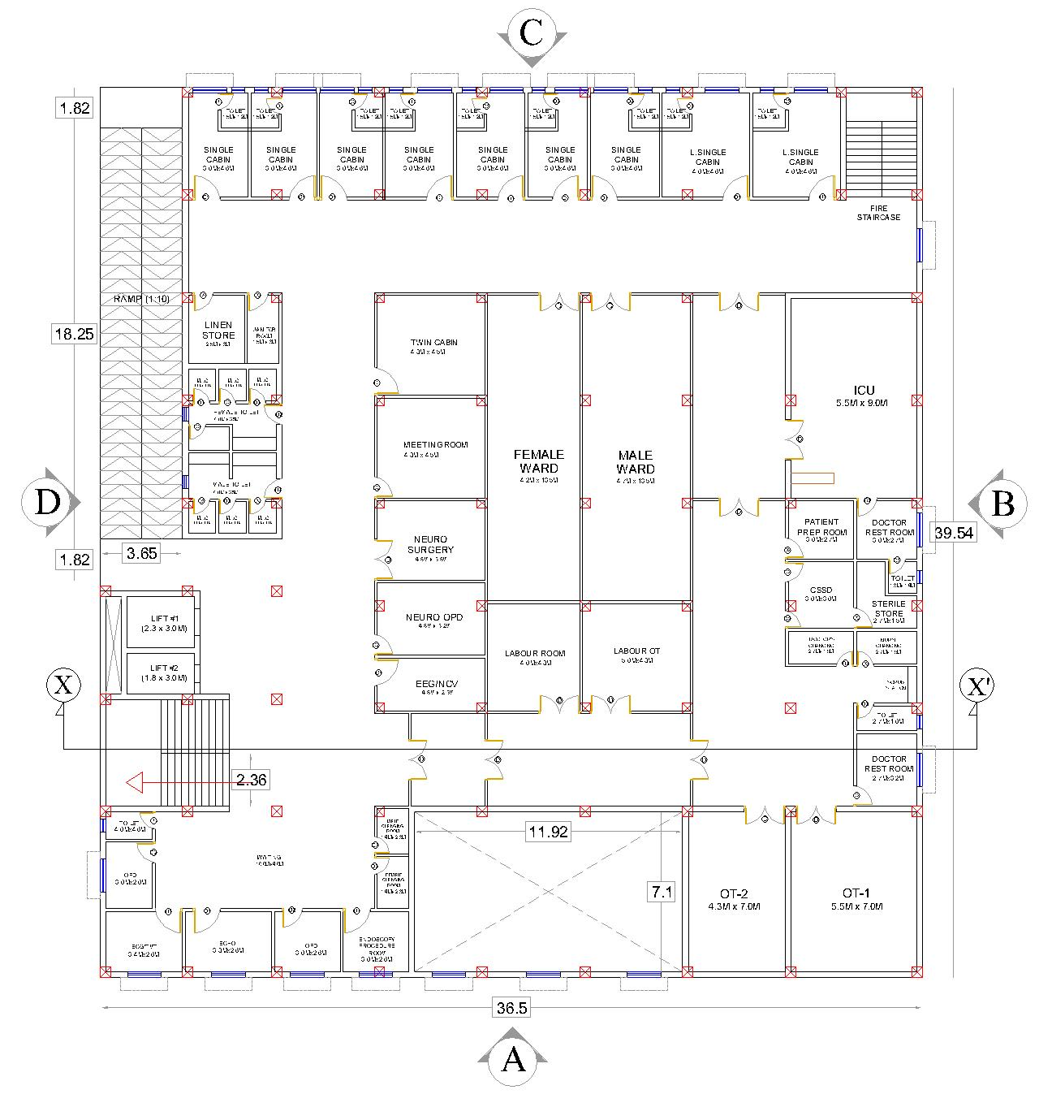
First floor
SPECIALITY OPD
DEPARTMENT OF NEUROLOGY
IPD
LABOUR WARD
OT DEPARTMENT
ICU

Slide 14

Thank you.
MANOEURVE
GAJAPATI NAGAR, BBSR

