Slide 1


3D RENDERS
30 BEDED HOSPITAL
AT SAMBALPUR

Slide 2
day VIEW

Slide 3
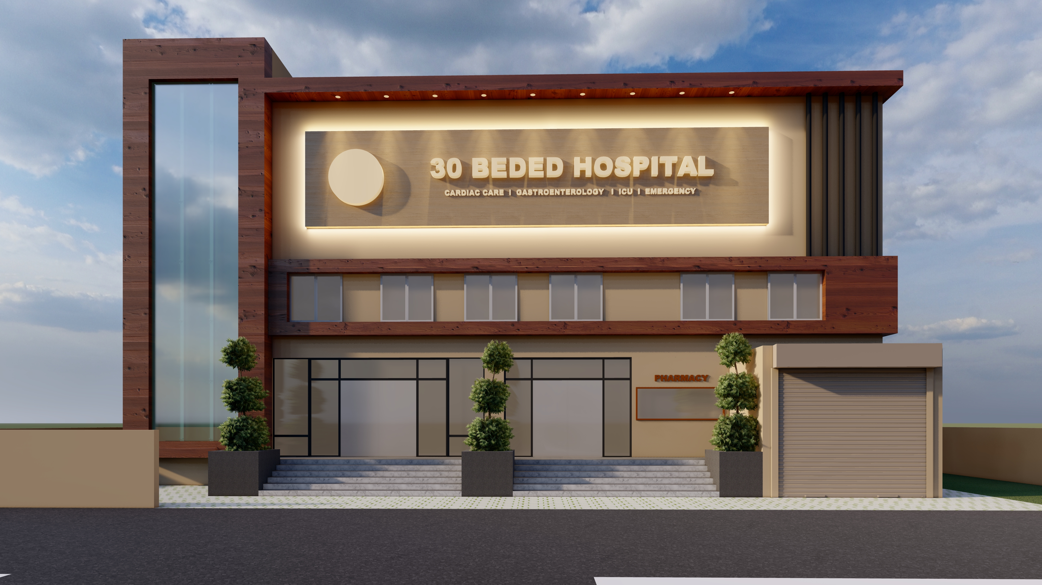

Slide 4
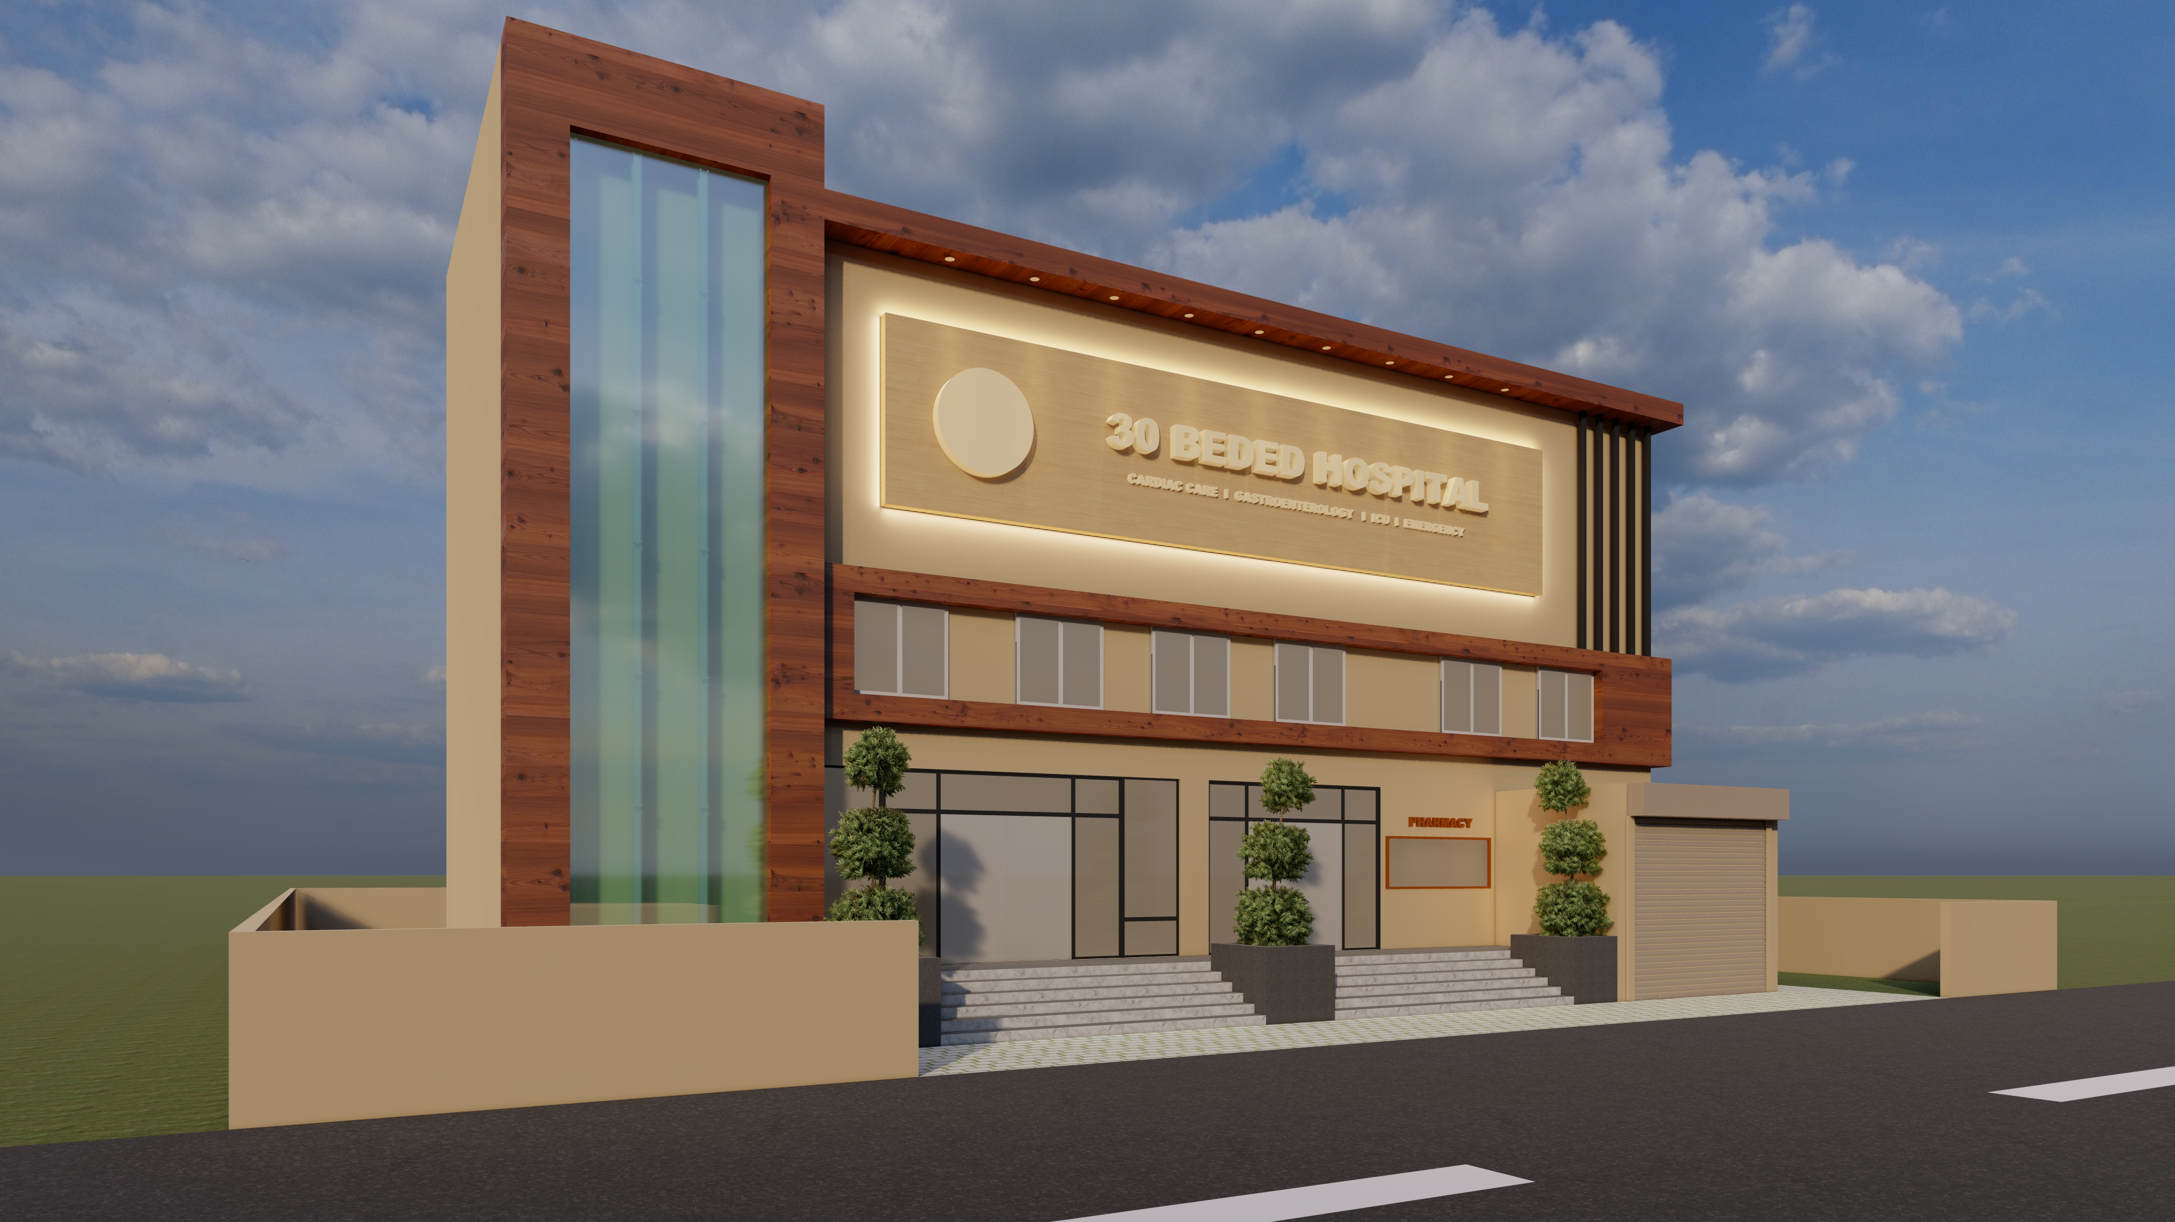

Slide 5
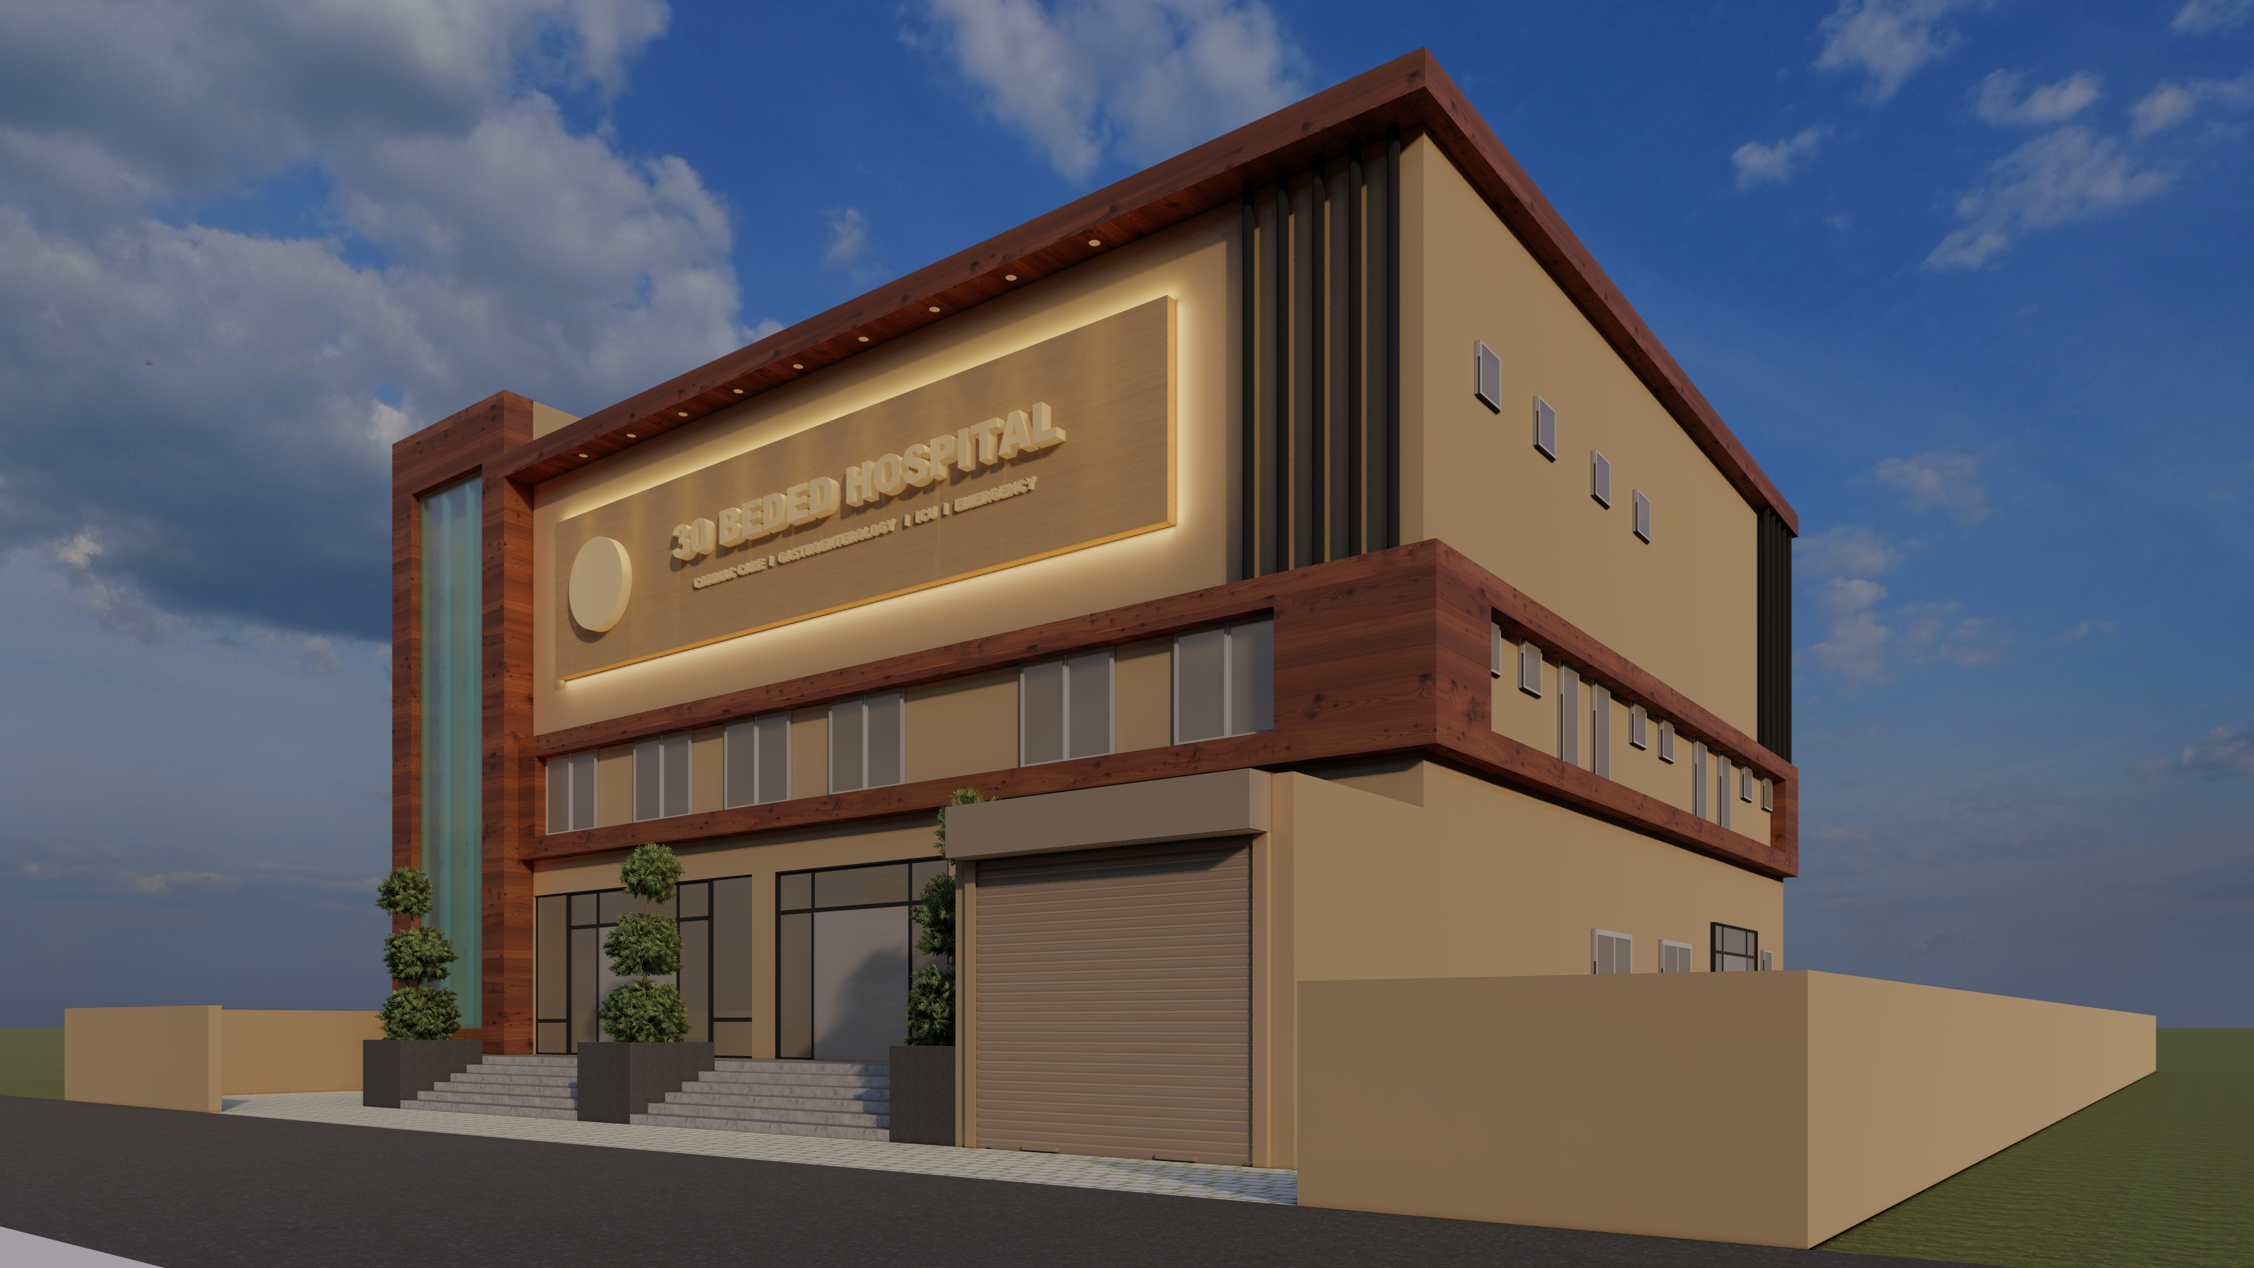

Slide 6
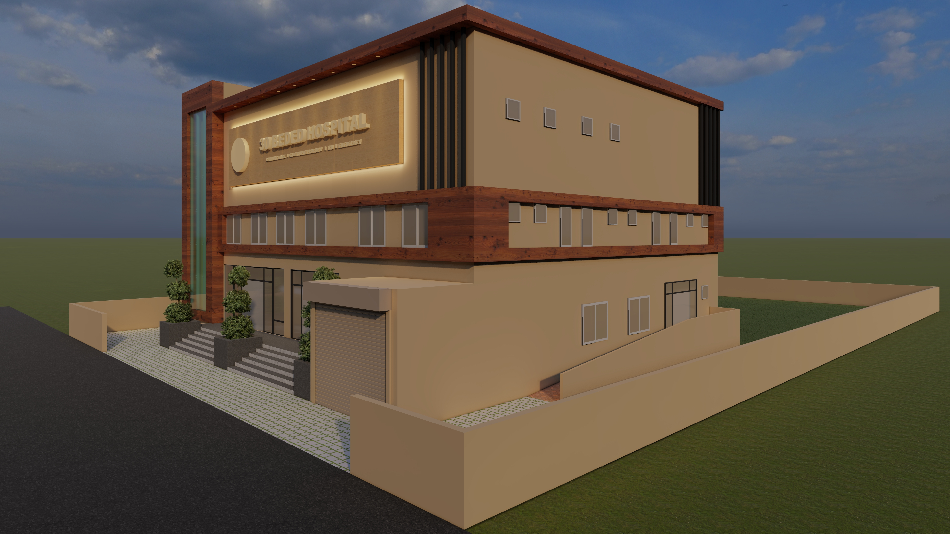

Slide 7
night VIEW

Slide 8
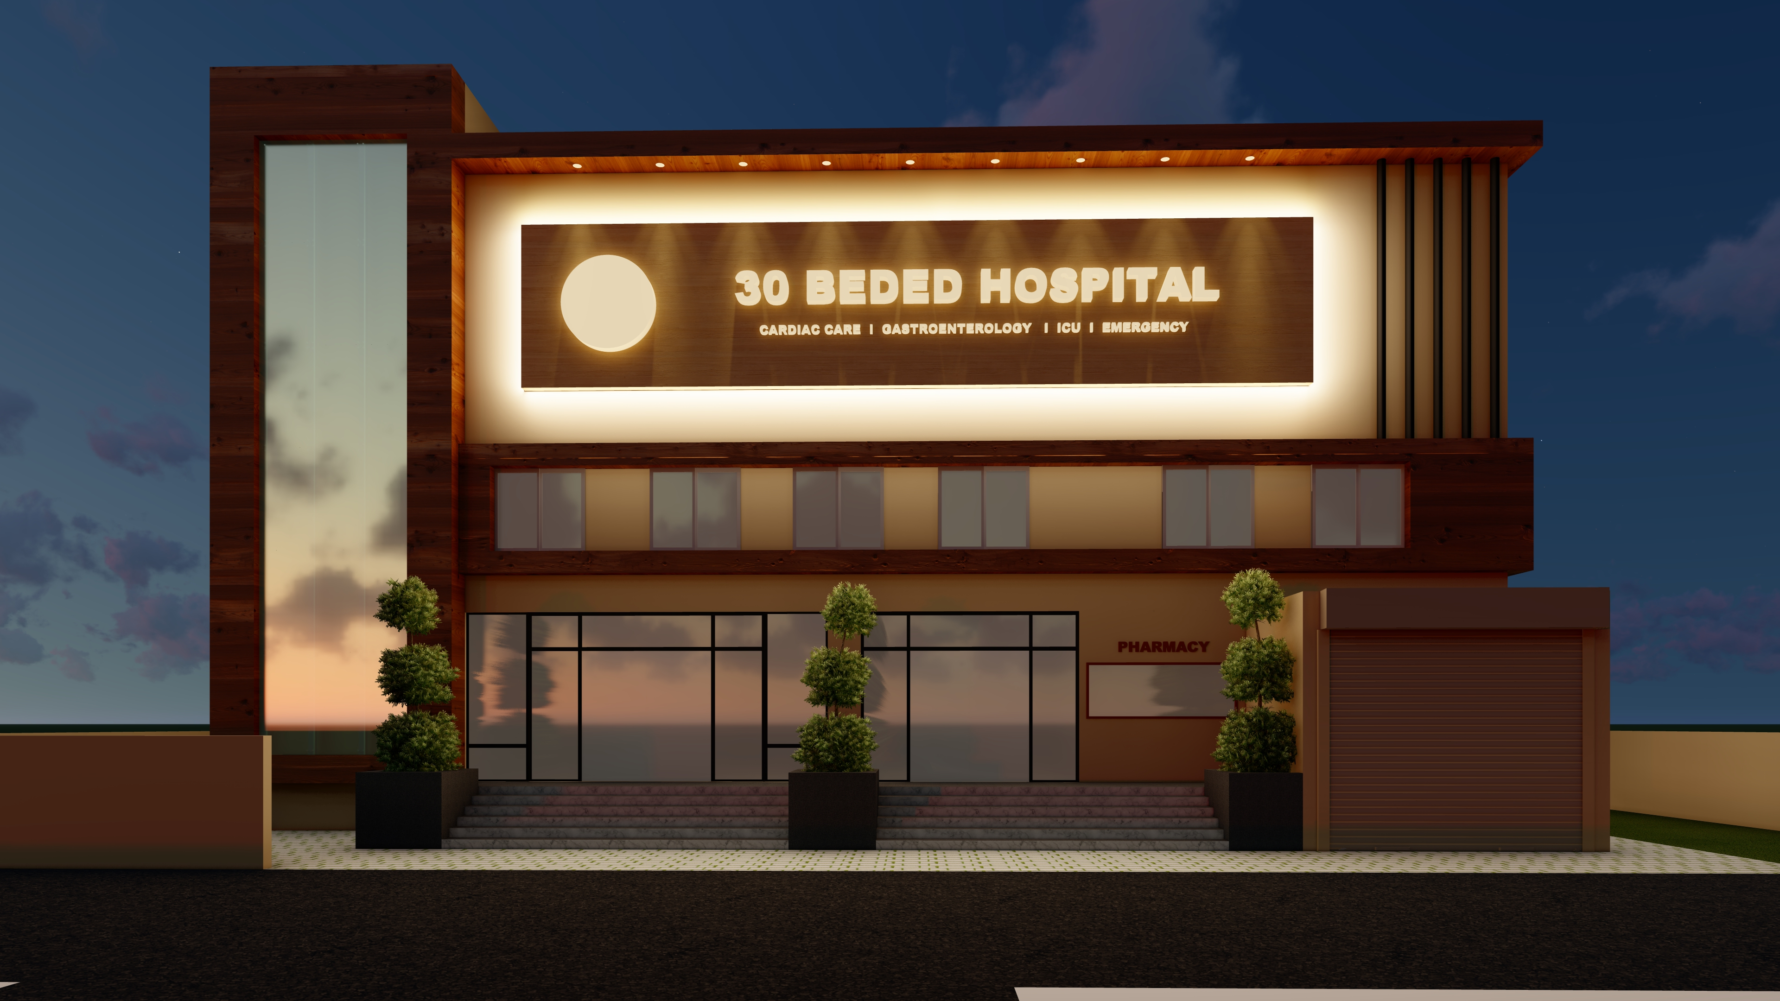

Slide 9
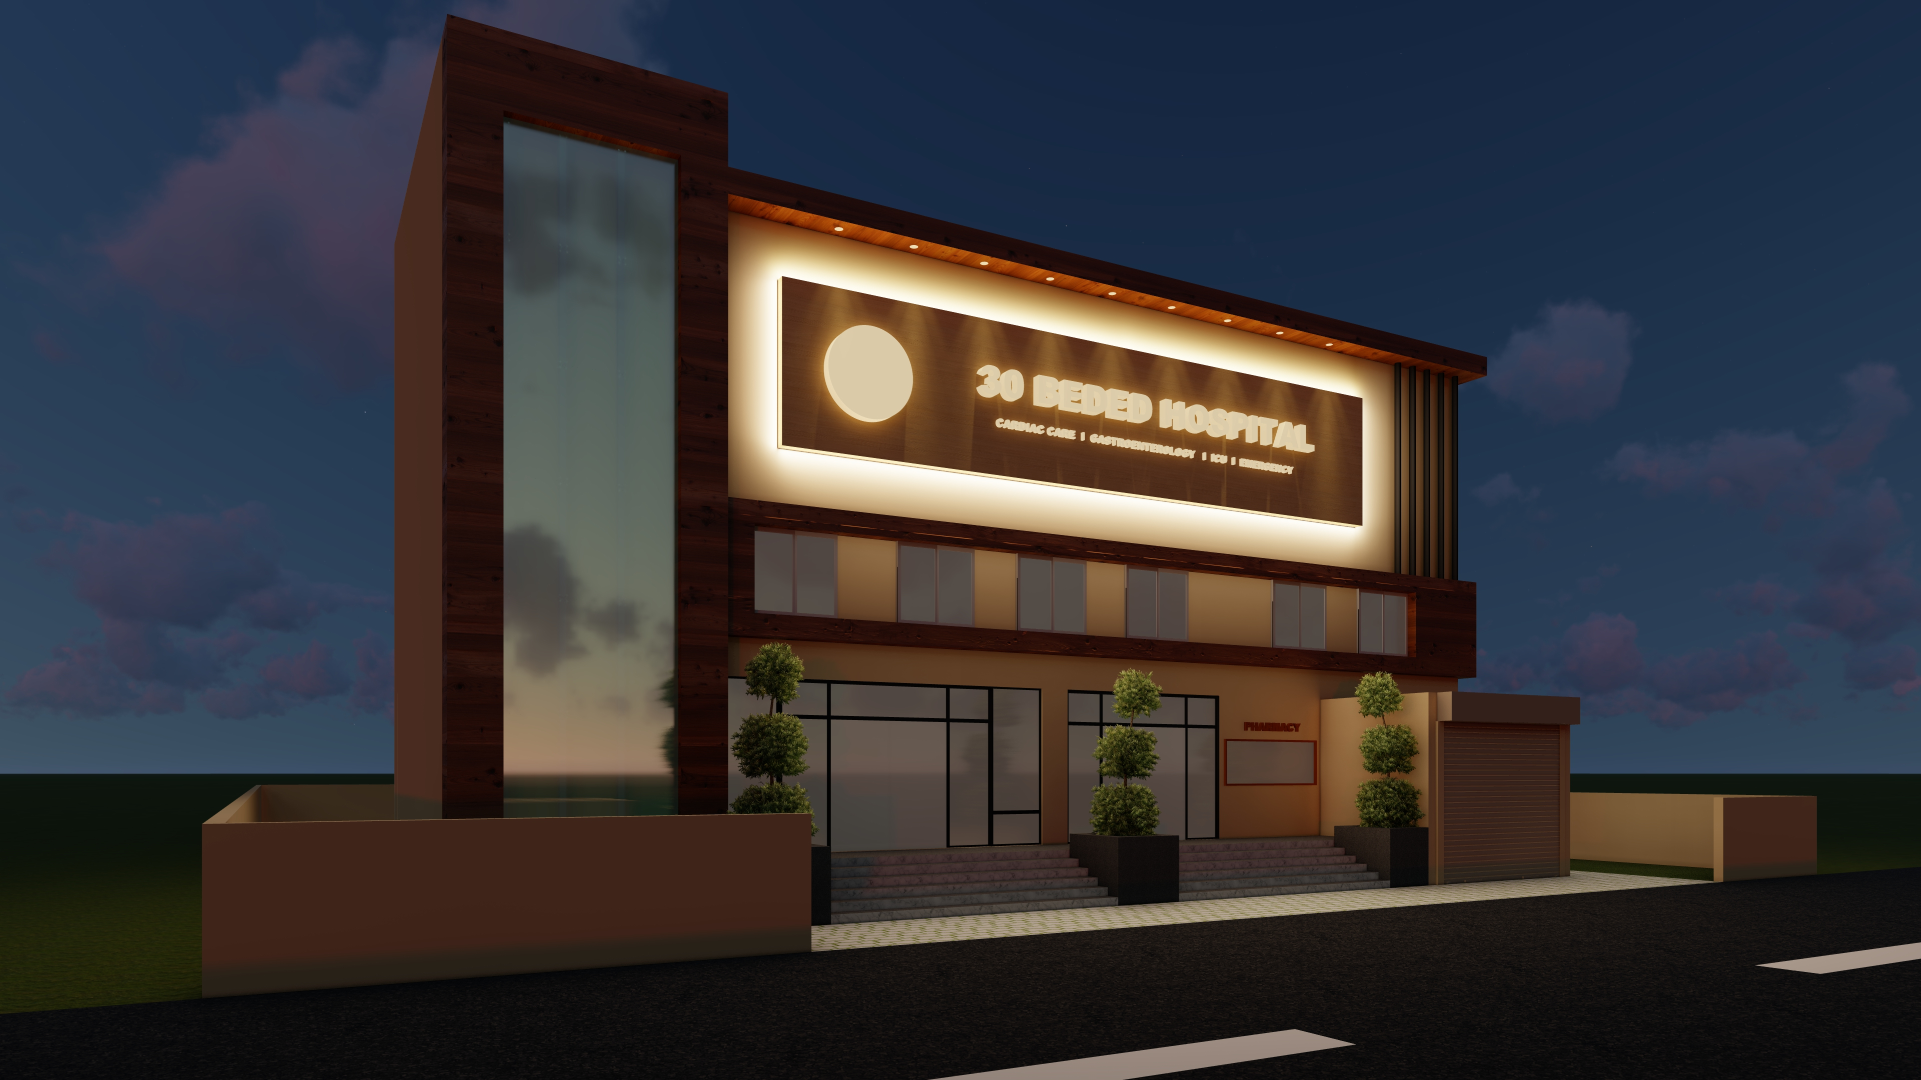

Slide 10
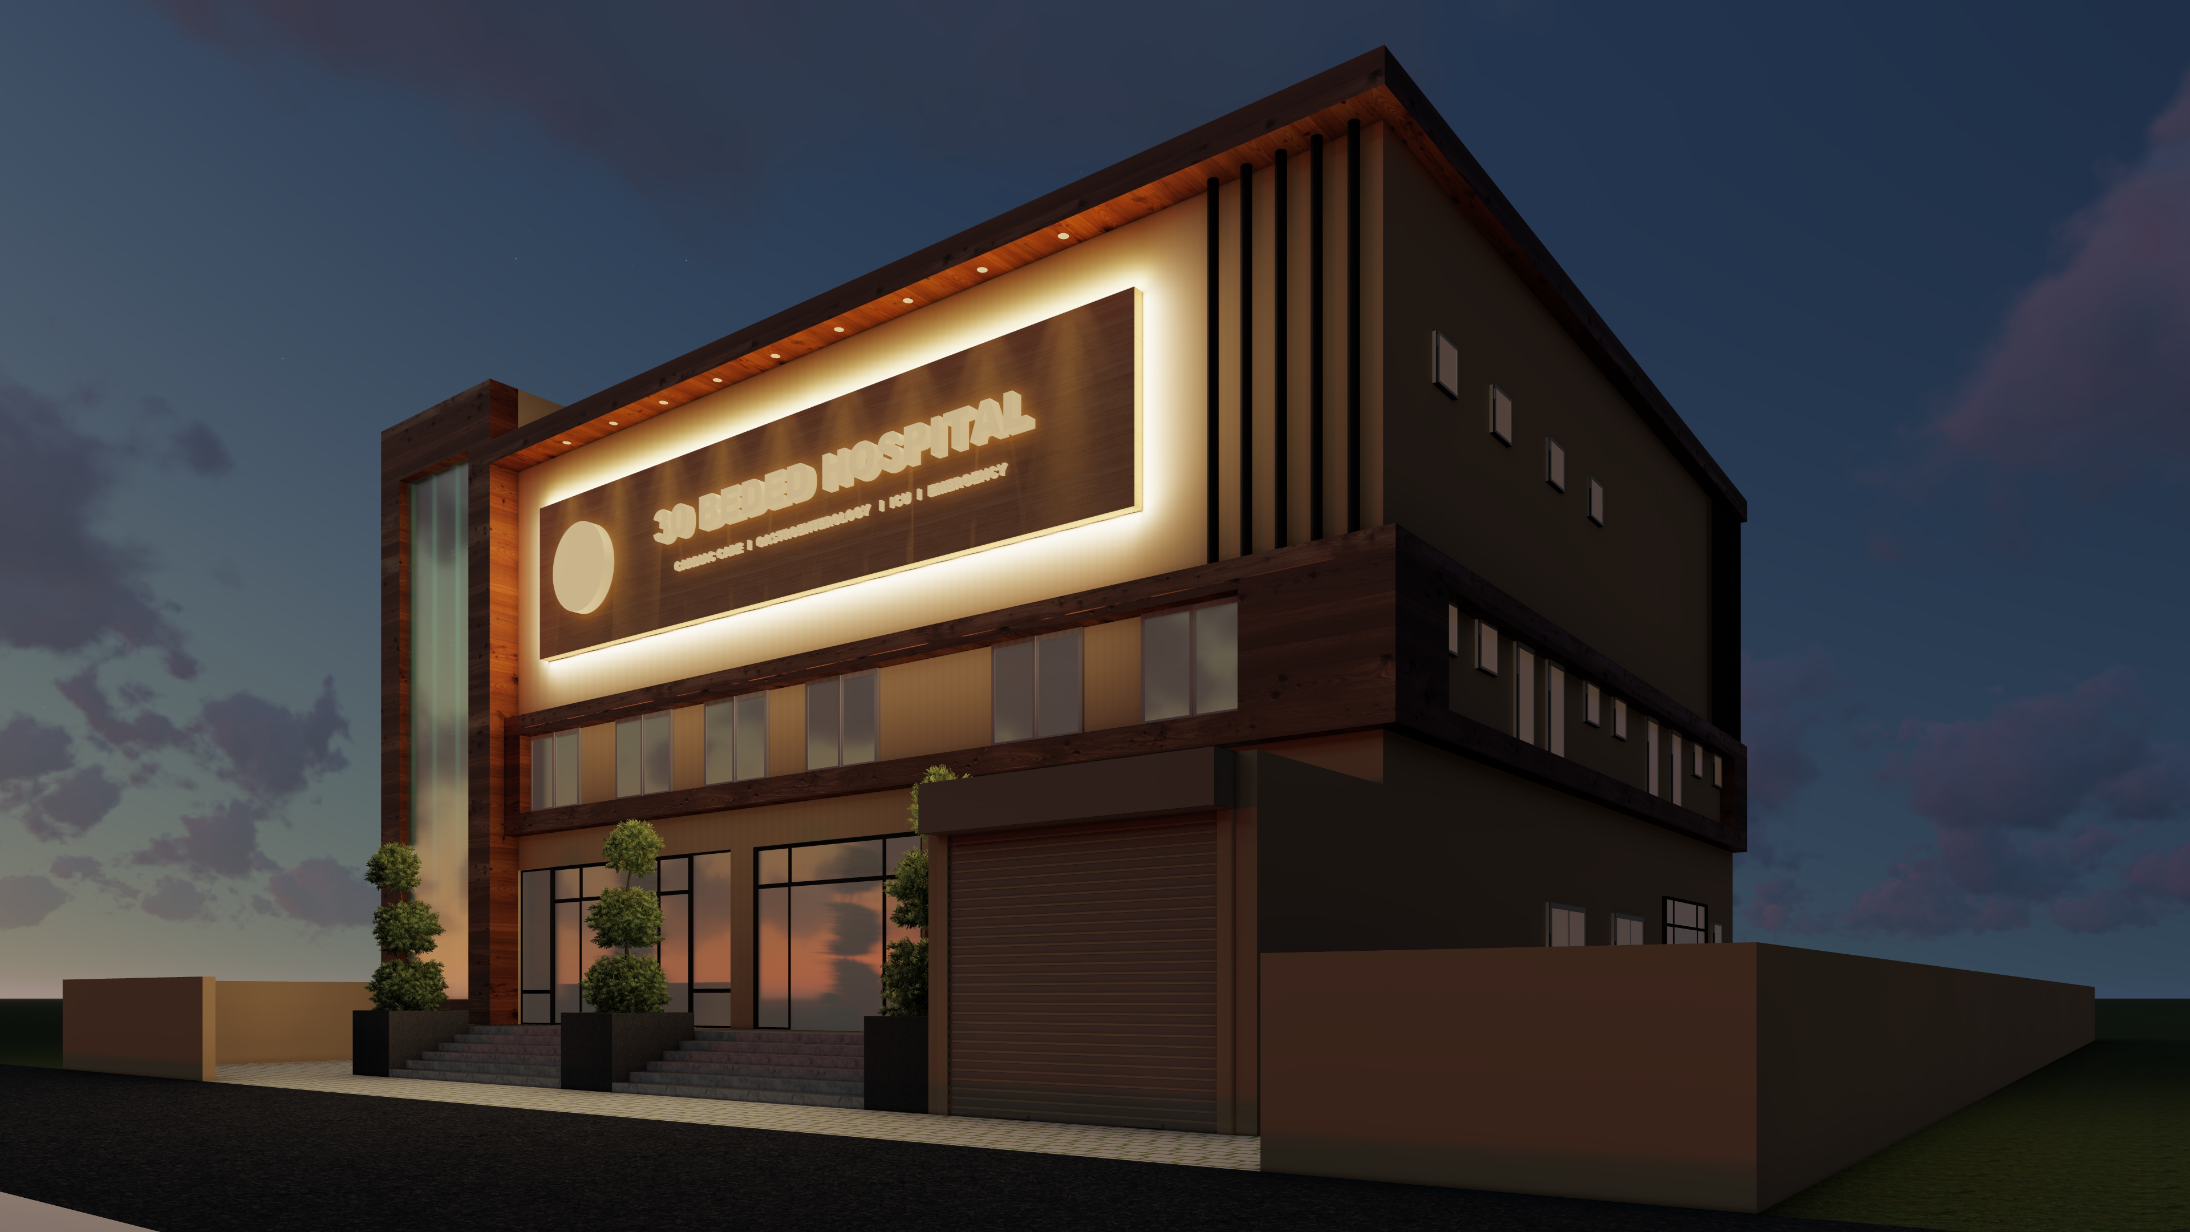

Slide 11
